Slide 1




Privacy & Security in Online Social Media
Week 3: Part 1 BS in Data Science and Applications
Ponnurangam Kumaraguru (“PK”)
#ProfGiri CS IIIT Hyderabad
https://www.instagram.com/pk.profgiri/
https://www.linkedin.com/in/ponguru/

Slide 2
Questions?

Slide 3
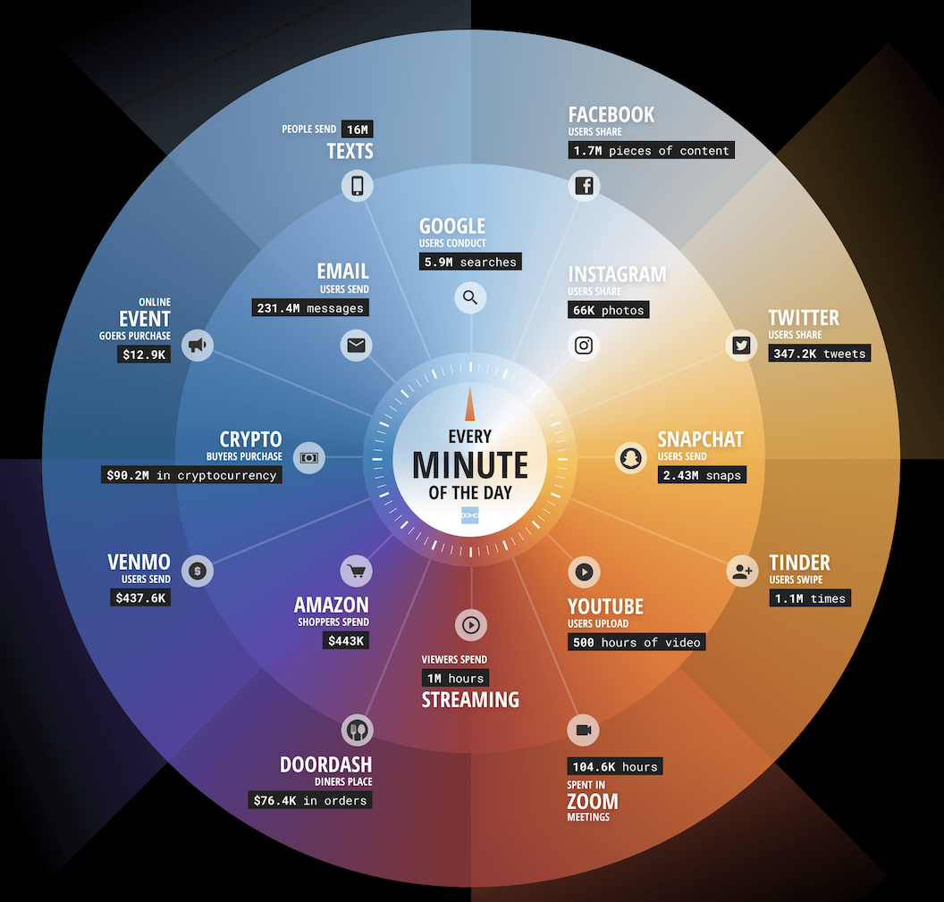
Looking back at our prev "Internet Minute in 2022" slide
How much of this is textual data?
Explosion of Text data.
https://www.domo.com/data-never-sleeps

Slide 4
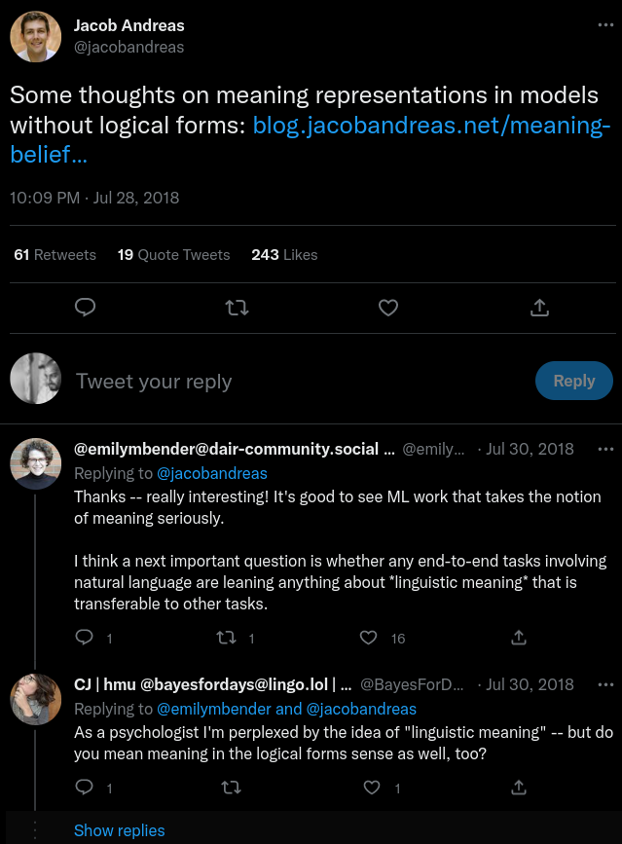
Where all can we find text in Online Social Networks
Social Network Posts – Tweets / Threads
Hierarchy in posts – Post
Reply
Reply-to-a-Reply
* and many such branches
Hierarchy encodes context that is crucial for processing text for meaningful tasks
Tweet
Reply
Reply to a Reply
Jacob Andreas Tweet

Slide 5
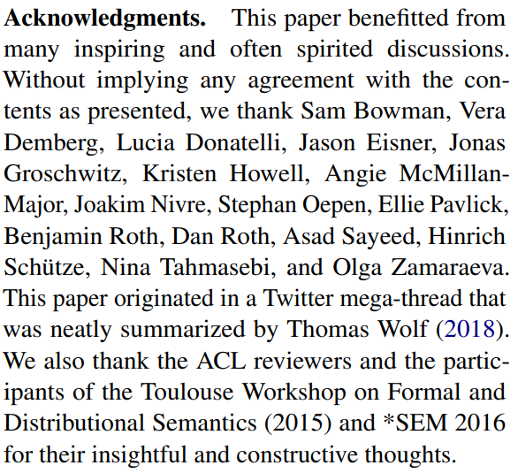

Where all can we find text in Online Social Networks
SideNote: This Twitter mega-thread, lead to a ACL'2020 Best Paper Award.
*ACL = Association of Computational Linguistics, a top-NLP conference.

Slide 6


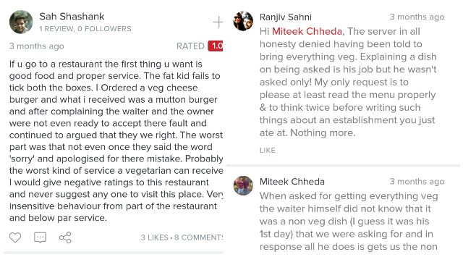
Where all can we find text in Online Social Networks
Product Reviews
Restaurant Reviews
https://www.cnet.com/pictures/funniest-amazon-reviews-products/10/
https://scroll.in/magazine/812253/x-why-indian-restaurants-are-yelling-back-at-negative-online-reviewers

Slide 7

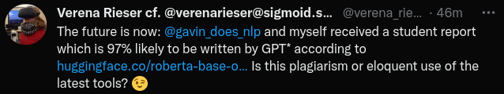
Artefacts of Social Media Text
Hashtags - #AI
Emojis -
URLs : huggingface.co.....
User Mentions - @gavin_does_nlp
https://twitter.com/verena_rieser/status/1603305659117731841

Slide 8
Artefacts of Social Media Text
Hashtags
Emojis
URLs
User Mentions
Some carry semantic information - Hashtags
"#SuperMovie #Avengers" -> "Super Movie Avengers"
Others are useful in getting more information / context around a post - URLs
"Check out our model details at https......."

Slide 9
Quirks of social media text
Spelling Variations
Romanization : मेरा == mera , merra, meraa, mra
Character Limits : Good Night == Gud ni8

Slide 10
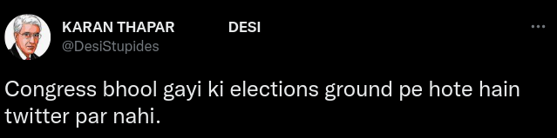


Quirks of social media text
Multilingual & Code mixing
Multilingual Speakers can and will mix languages
https://twitter.com/DesiStupides/status/1326360135233462272

Slide 11
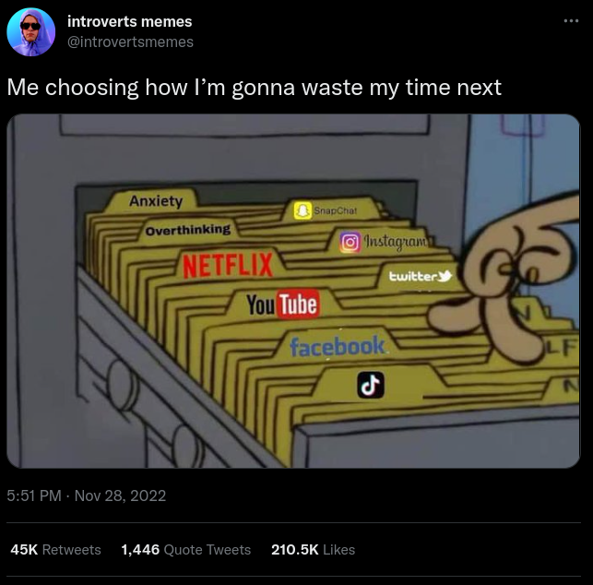
Quirks of social media text
Multimodal – Text makes sense when coupled with associated media.
https://twitter.com/introvertsmemes/status/1597203946774597636

Slide 12
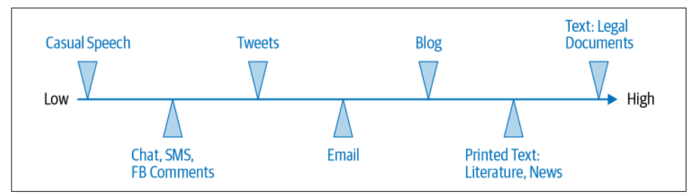
Quirks of social media text
Domain & Style Difference
Very different to, say, Wikipedia/News Text
Platform / User enforced Constraints : 280 Character Limit
All the information is not present in surface form – humor , sarcasm, anecdotes.
Spectrum of formalism in text data depending on data sources
Reference : Practical Natural Language Processing by Sowmya Vajjala, Bodhisattwa Majumder, Anuj Gupta, Harshit Surana

Slide 13

Preprocessing
All the quirks that we discussed in previous slides have an impact on how we process social media text and gain insights
Do I treat OSN text differently?
Popular NLP Approaches/Models
Text from Online Social Networks

Slide 14
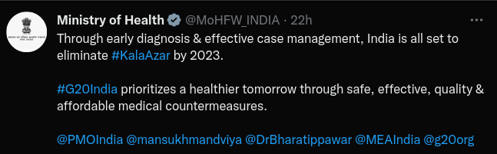
Preprocessing
Most NLP toolkits are usually trained on large crawled Corpora. Because they are available on a large scale.
But can these tools be used for social media text?
For ex : A Named Entity Detector trained on News/Wikipedia text, will it work on tweets?
A lot of information can be extracted from artefacts. But they also cause noise
Ref: https://twitter.com/MoHFW_INDIA/status/1611333738289397763

Slide 15
Preprocessing
Preprocessing Social Media Text usually has two objectives.
Preprocessing would help NLP tools perform better
Preprocessing social media text goes a long way in leveraging existing NLP toolkits

Slide 16
Preprocessing
All the quirks that we discussed in previous slides have an impact on how we process social media text and gain insights
Most NLP toolkits are usually trained on News Corpus / Wikipedia Corpus. Because they are available on a large scale. But can these tools be used for social media text?
A lot of information can be extracted from artefacts. But they also cause noise
Preprocessing Social Media Text
Preprocessing would help NLP tools perform better
Preprocessing social media text goes a long way in leveraging existing NLP toolkits

Slide 17
Preprocessing
Cleaning Text – First step in any NLP Pipeline
Remove information that you don't want
OR
Refactor certain information in a certain way that helps your task

Slide 18
Preprocessing
Cleaning Text – First step in any NLP pipeline
I saw the new #johndoe movie and it suuuuucks!!! WAISTED $10... #badmovies :/"

Slide 19
Preprocessing
Cleaning Text – First step in any NLP pipeline
i saw the new <hashtag> john doe </hashtag> movie and it sucks <elongated> ! <repeated> waisted <allcaps> <money> . <repeated> <hashtag> bad movies </hashtag> <annoyed>
I saw the new #johndoe movie and it suuuuucks!!! WAISTED $10... #badmovies :/"
Replace artefacts with indicators.
Example taken from Ekpharasis's GitHub Example : https://github.com/cbaziotis/ekphrasis

Slide 20
Preprocessing
Cleaning Text – First step in any NLP pipeline
i saw the new <hashtag> john doe </hashtag> movie and it sucks <elongated> ! <repeated> waisted <allcaps> <money> . <repeated> <hashtag> bad movies </hashtag> <annoyed>
I saw the new #johndoe movie and it suuuuucks!!! WAISTED $10... #badmovies :/"
i saw the new john doe movie and it sucks ! waisted $10. bad movies
Remove the artefacts completely.

Slide 21
Preprocessing
Cleaning Text – First step in any NLP pipeline
i saw the new <hashtag> john doe </hashtag> movie and it sucks <elongated> ! <repeated> waisted <allcaps> <money> . <repeated> <hashtag> bad movies </hashtag> <annoyed>
I saw the new #johndoe movie and it suuuuucks!!! WAISTED $10... #badmovies :/"
i saw the new john doe movie and it sucks ! waisted $10. bad movies
Replace / Remove – Depends on your application.
Notes:
The two alternatives are handling the artefacts differently.
Option 1 : removes the hashtag, or segments them, but also adds the <hashtag> & </hashtag> tags to mark bounds. Removes emoji
Option 2 : Just segments the hashtag.. Removes emoji In option1 , you have cleaned it , but also preserved some more infomration about those tokens by adding tags – which might be useful .
In option2, you have just cleaned them. Which one to do – entirely application dependent. For some just cleaning is sufficient.

Slide 22
Preprocessing
Tokenisation – Breaking a sentence into constituent tokens
I saw the new #johndoe movie and it suuuuucks!!! WAISTED $10... #badmovies >3:/
White Space
['I', 'saw', 'the', 'new', '#johndoe', 'movie', 'and', 'it', 'suuuuucks!!!', 'WAISTED', '$10...', '#badmovies', '>3:/']
Tool1
['I', 'saw', 'the', 'new', '#', 'johndoe', 'movie', 'and', 'it', 'suuuuucks', '!!!', 'WAISTED', '$', '10', '...', '#', 'badmovies', '>', '3', ':/']
Tool2
['I', 'saw', 'the', 'new', '#johndoe', 'movie', 'and', 'it', 'suuuuucks', '!', '!', '!', 'WAISTED', '$10', '.', '.', '.', '#badmovies', '>', '3:/']
Example taken from Ekpharasis's GitHub Example : https://github.com/cbaziotis/ekphrasis
Notes:
Tool 1 : is a tokenizer that is generally used for any text. #johndoe -> # john doe. Emoji is broken down.
Tool 2 : is a social media tokenizer , handle hashtags, emojis tokenisation differently.

Slide 23
Preprocessing
Code Mixed Text
Which word belongs to which language – Language Identification
If written in romanised form , convert into native script - Normalisation
Sentence : I thght mosam different hoga bs fog h
Token | Normalised | Language ID
i | i | en
thght | thought | en
mosam | मौसम | hi
dfrnt | different | en
hoga | होगा | hi
bs | बस | hi
fog | fog | en
h | है | hi
Example taken from CSNLI GitHub : https://github.com/irshadbhat/csnli

Slide 24
In Summary
Abundance of Text on Social Networks
Artefacts of Social Media Text – Hashtag, User Mention etc
Quirks of text on Social Networks – Spelling Variations, Multilingualism
Preprocessing – Cleaning , Tokenisation

Slide 25
Thanks!

